Slide 1
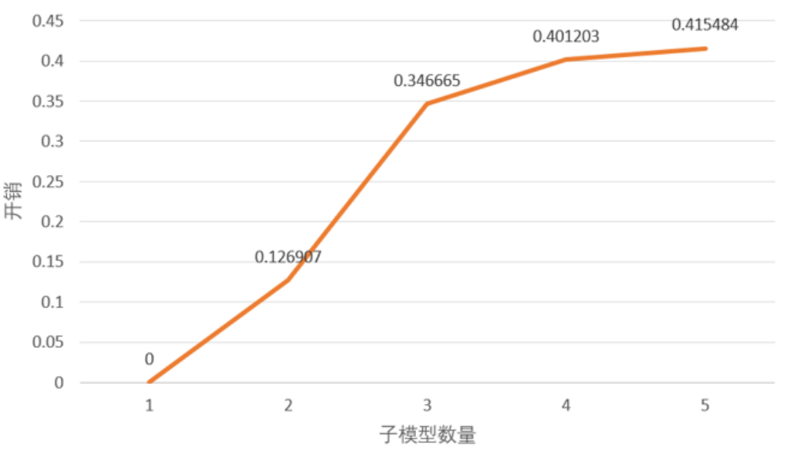
Overhead
Number of submodels

Slide 2
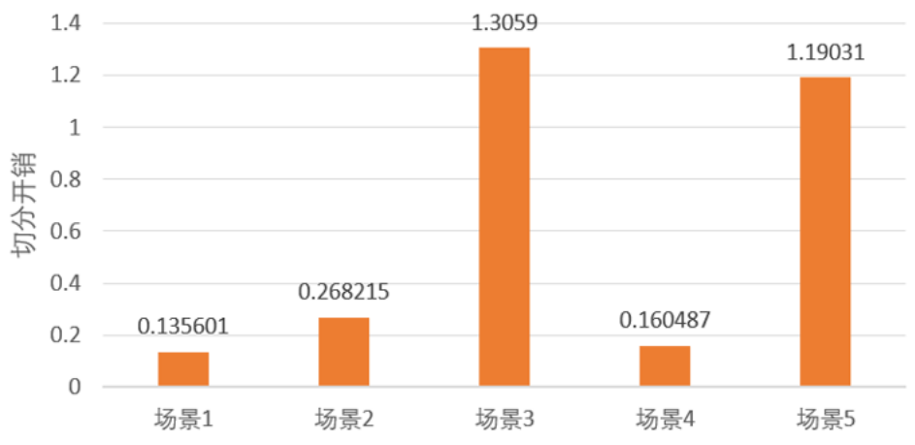
Overhead
1
2
3
4
5
Strategy

Slide 3
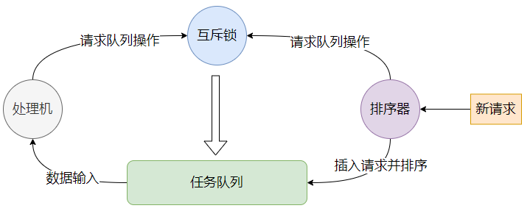

Slide 4
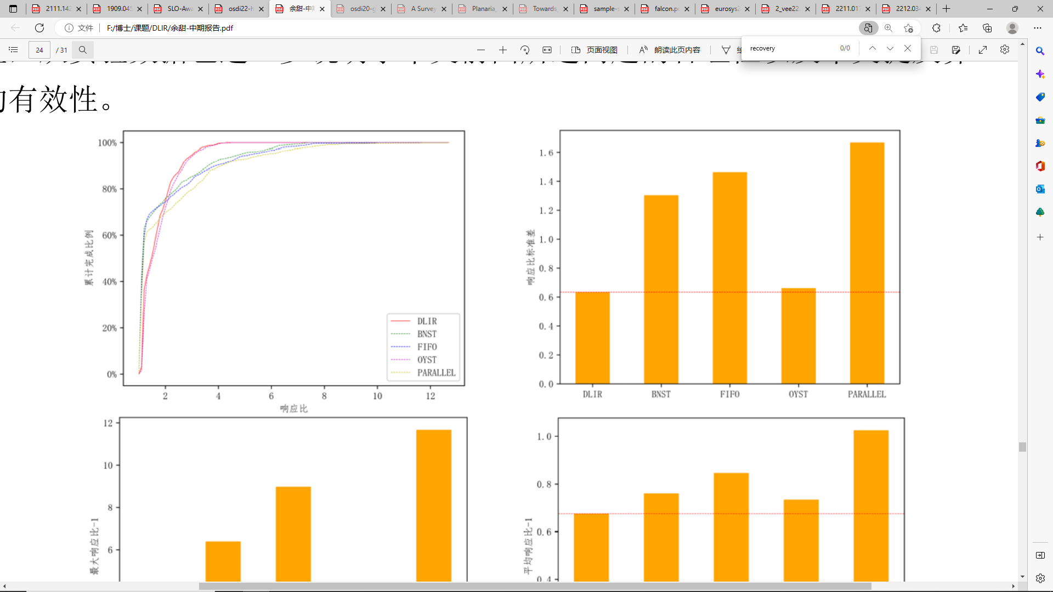
Percentage of tasks completed
Std. deviation of response ratio
Response ratio

Slide 5
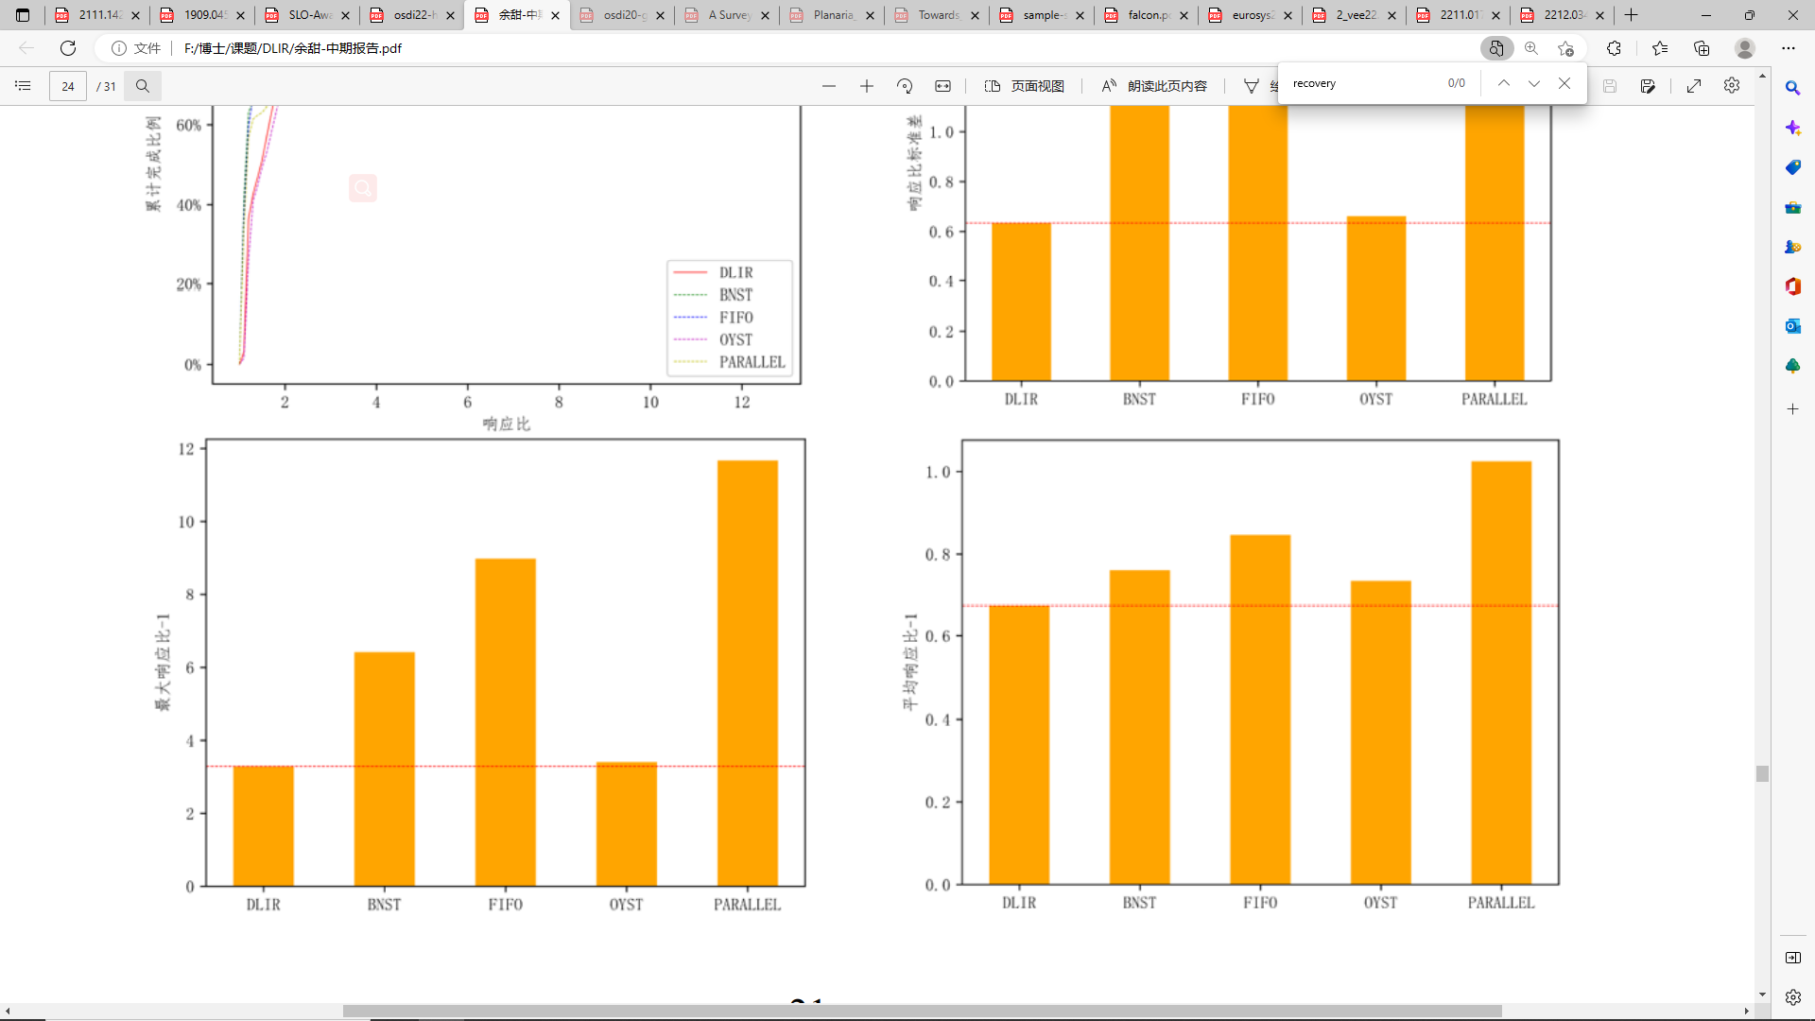
Maximum response ratio -1
Average response ratio -1

